Slide 1
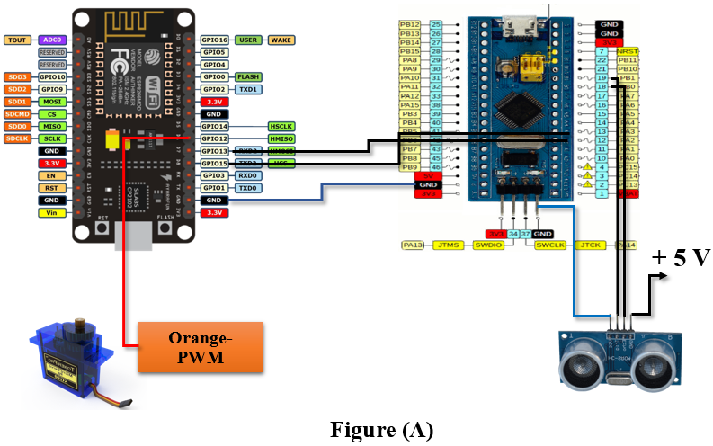
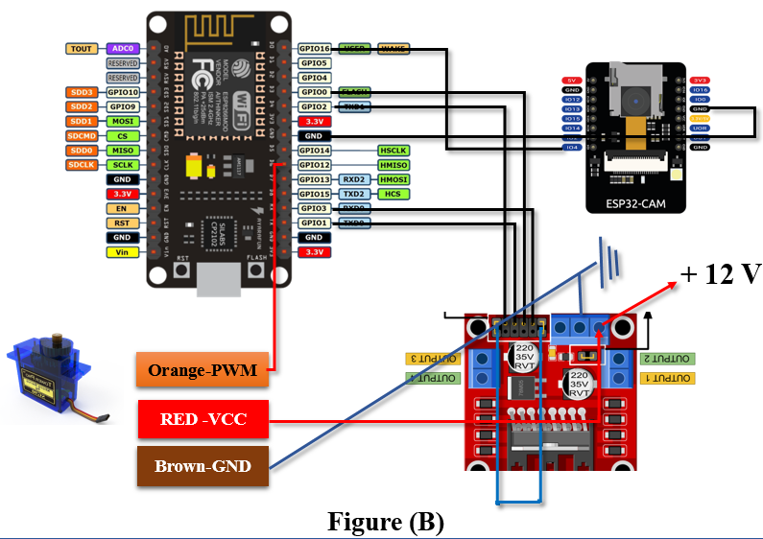
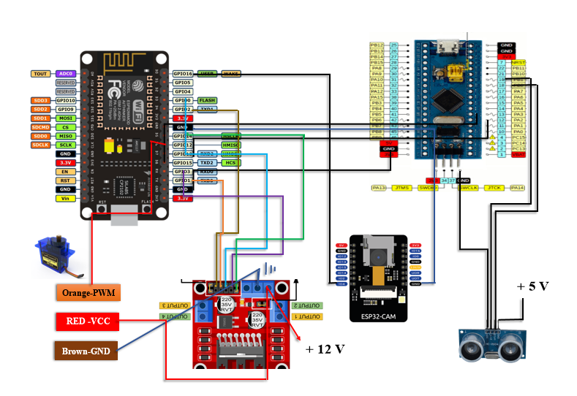
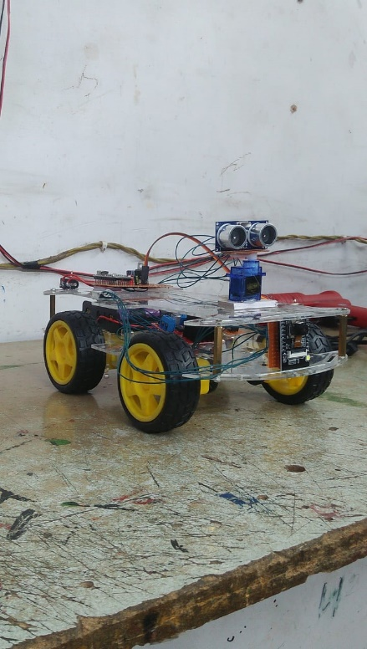
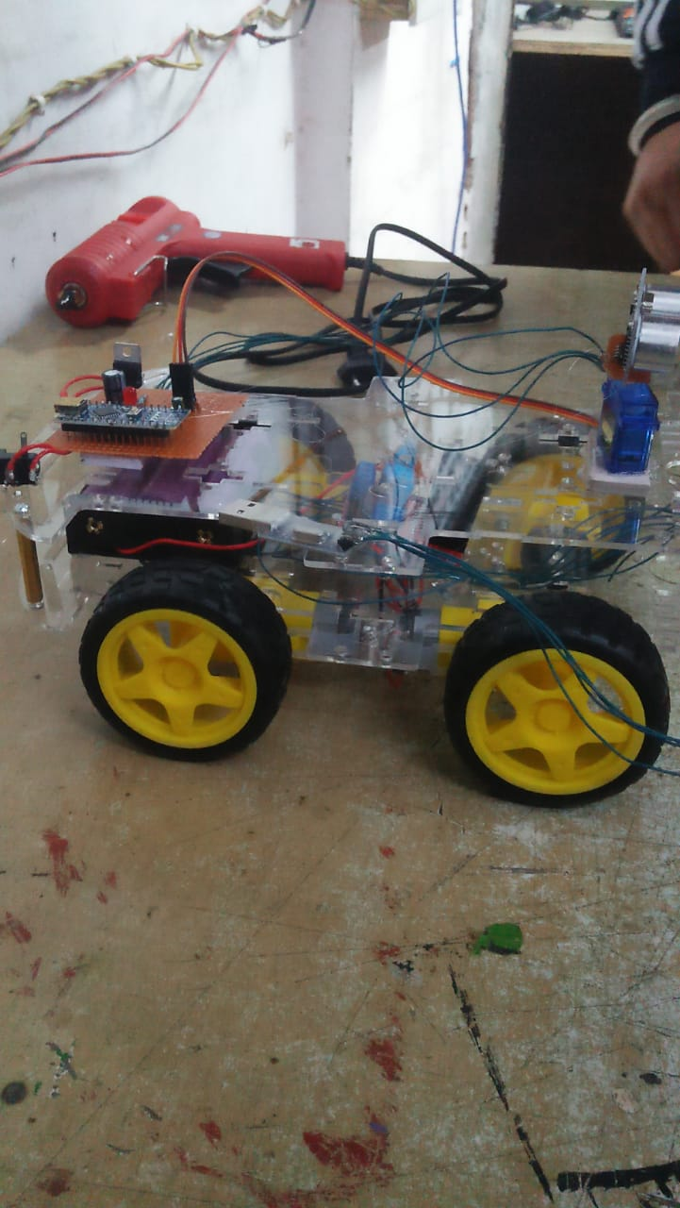
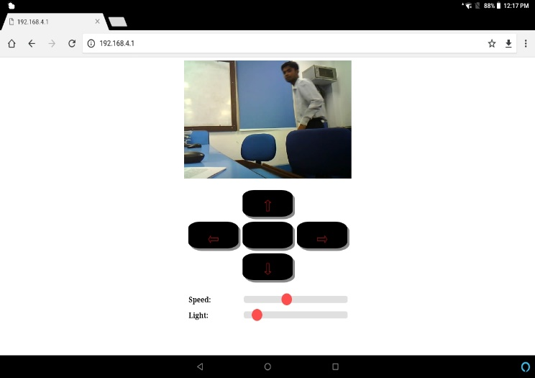
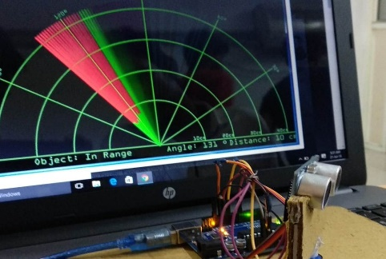
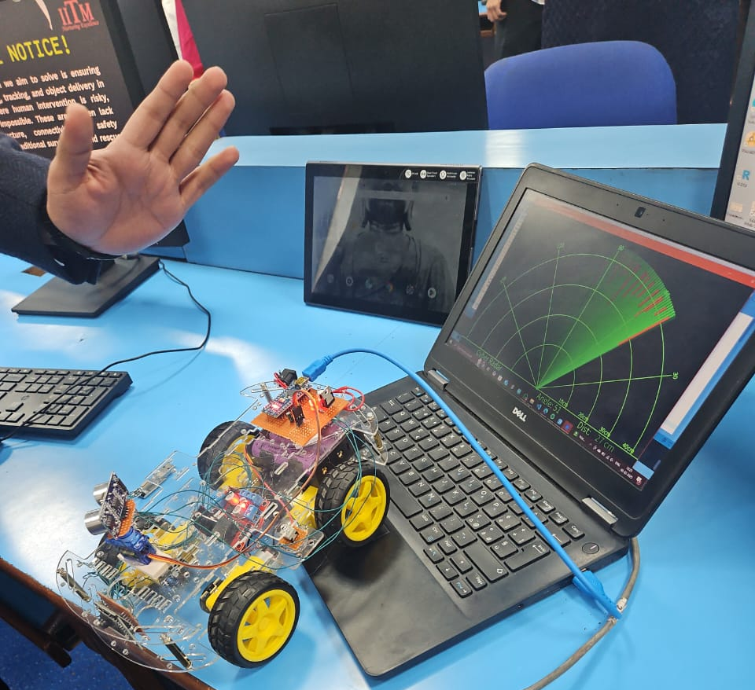
IntelliGuard: IoT-Enabled Autonomous Spybot Intelligence for Real-Time Surveillance in Next-Generation Security Applications
Dhruv Dhayal, dhayaldhruv271@gmail.com, Pratham Aggarwal, aggarwalpratham2602@gmail.com
Supervised by: Dr. Manzoor Ansari
Institute of Information Technology and Management (IITM)
Introduction
System Architecture
Selected Results
Designed for remote monitoring in high-risk areas with no human intervention reduce the risk of human causalities.
Radar-based obstacle detection displaying location, distance, and angle with GUI Interface.
Real-time surveillance and enemy tracking with private IP integration on a secure tablet GUI for government & Millitary use so on, to reduce the problem by Iot-Based solutions.
Successful implementation of IoT-based real-time monitoring >40m of range without EMF Signal/Wi-Fi.
Accurate obstacle detection using radar and ultrasonic sensors give distance & angle.
Continuous Operation with less time latency with the proper optimized power supply management.
Achieved Goals
Enhanced security in high-risk environments with real-time threat detection.
Minimized human exposure through autonomous monitoring to reduce risks and enhance safety in worse situations.
Long-range remote monitoring via private IP and without EMF (>40m).
Reliable autonomous operations with AI-driven decision-making.
Problem & Motivation
High-risk zones like pipelines, mines, borewells and military areas endanger lives due to lack of real-time monitoring survilleance.
An autonomous system is needed to detect threats, gather intelligence, and provide live feedback, minimizing human exposure and enhancing safety.
System Prototype
Conclusion
Autonomous surveillance
Minimized human exposure
Optimized power efficiency
Real-world application
Secure remote access
Real-time threat detection
Cost-effective solution
Approach & Technology
IoT-Based Real-Time Monitoring for autonomous surveillance and decision-making.
L288N, ESP32-CAM, Radar System, HCSR04, SG-90, Dual Shaft BO Gear Motor 12V(100 RPM), Lithium Li-Ion (2000mAh, ESP8266 Node MCU, Private IP, GUI.

